Slide 1

Traffic Predictive Analytics using Computer Vision and Time Series Techniques
‹#›
Vincent Techo & Jacob Apia
7/26/2023

Slide 2
Content
Introduction
Goal
Data Acquisition
EDA
Modelling
Conclusion
Q&As

Slide 3
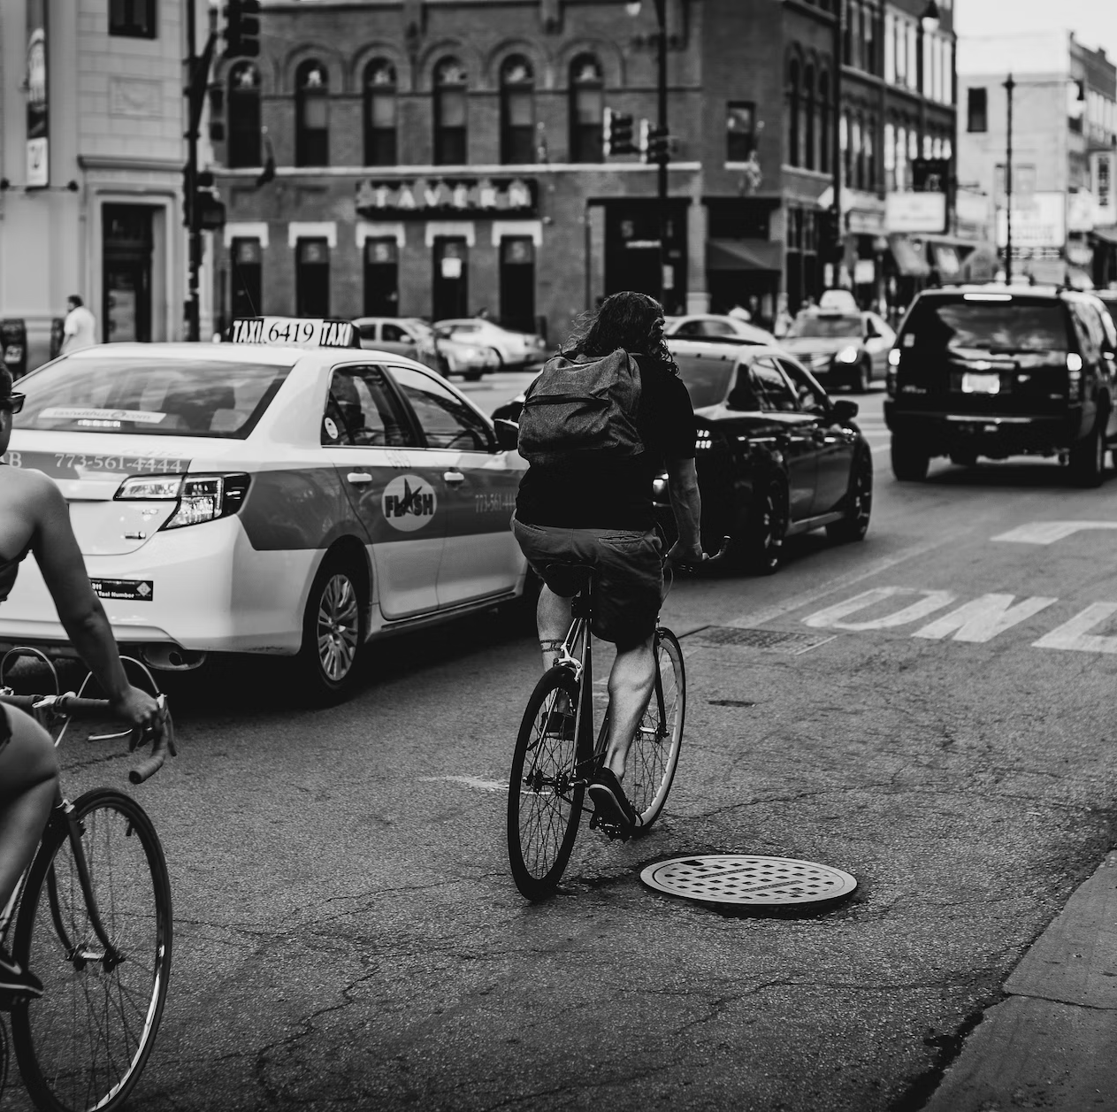
Introduction
‹#›
‹#›
Our Objective:
to gain insights into traffic behavior and create a predictive model to forecast car counts, which can have significant implications for urban planning and traffic management.
Applications:
Urban Planning
Traffic Management
Predictive Maintenance
Accident Prevention

Slide 4




Goal
‹#›
Develop a traffic prediction model for smart urban mobility using computer vision and time series analysis.
Integrate real-time traffic camera feeds with historical traffic and time series data to forecast congestion and traffic patterns.
(future plans) Optimize the model's performance with advanced machine learning techniques, deploy it in real-time, and enable continuous learning for dynamic traffic conditions.

Slide 5

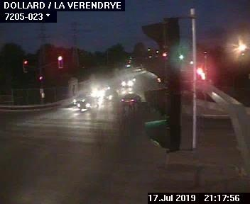
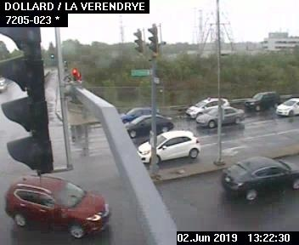
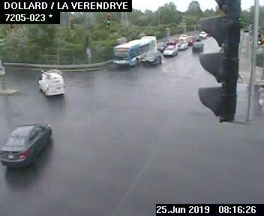
Data Acquisition
Images of a road intersection:
Dollard / La Verendrye—Quebec
Car Count Extraction: Open Source Computer Vision Library—(OpenCV)
DateTime Extraction: OCR technology

Slide 6
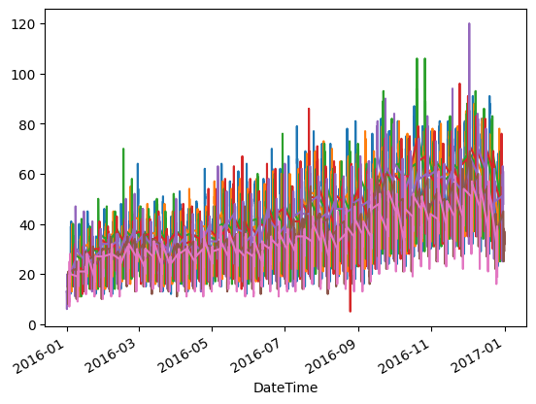
Data Description
‹#›
2 Columns: 8784 rows (hours)
Timeframe: 1 year
Number of cars per hour: 10-100
Notes:
Include vertical axis label

Slide 7
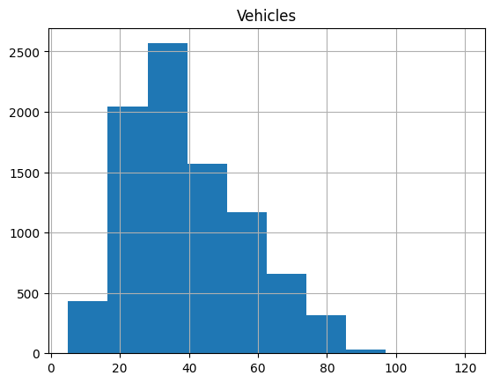
Data Description
‹#›
Distribution of number of vehicles per hour.
Median vehicle count: 30-40
Notes:
Please provide a better title. Vertical axis title

Slide 8
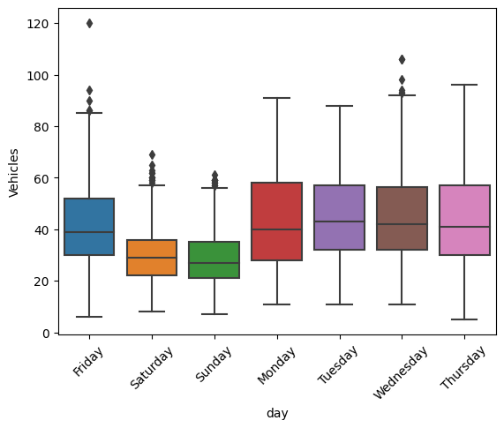
Data Description
‹#›
On average fewer vehicles drive through the road on weekends than they do on weekdays.

Slide 9

Computer Vision Modeling
‹#›
Car Count Extraction: OpenCV (cv2)
Object detection Algorithm: YOLOv3.
DateTime Extraction: OCR technology

Slide 10
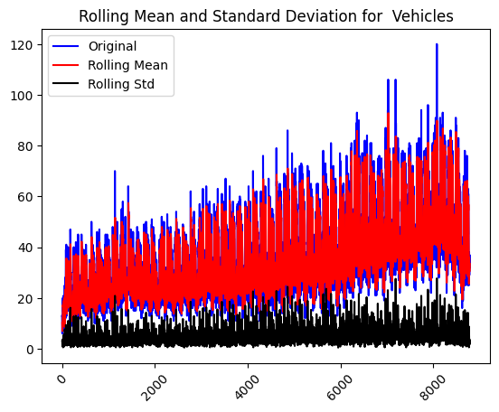
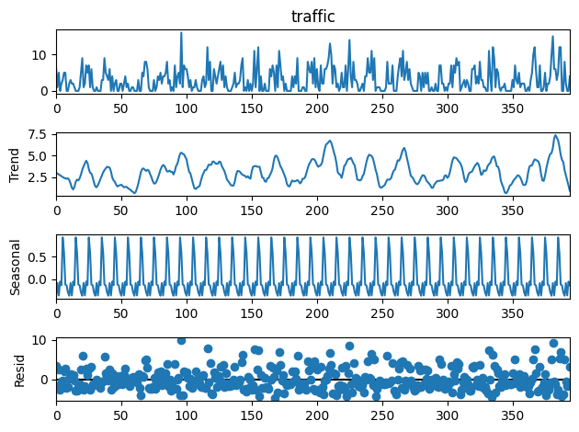
Time Series Modeling Trend, Seasonality, Residuals split
‹#›

Slide 11
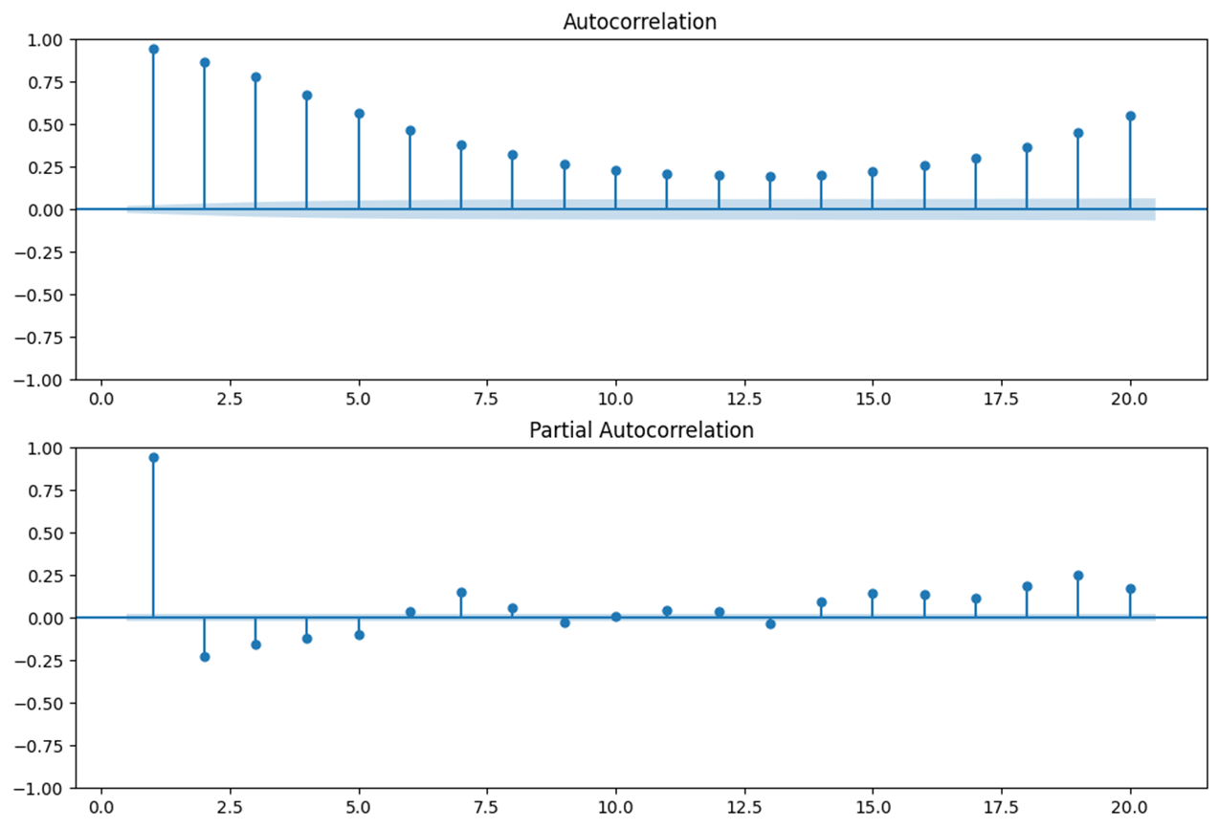
Time Series Modeling AutoCorrelations
‹#›

Slide 12
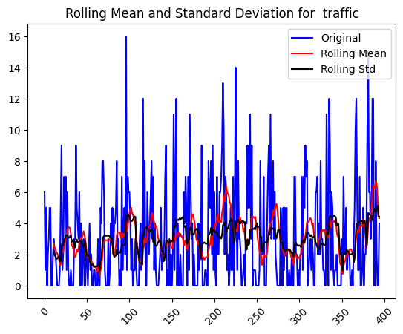
Time Series Modeling Stationarity check
‹#›
Test Statistic -9.235436
P-value: 1.635305e-15

Slide 13
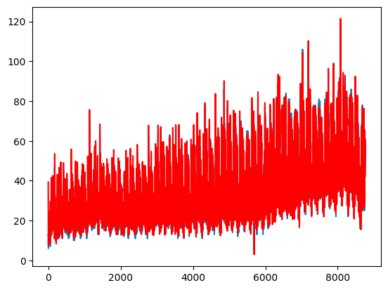
Time Series Modeling ARIMA Forecast: Train set
‹#›
RMSE: 5.0096

Slide 14
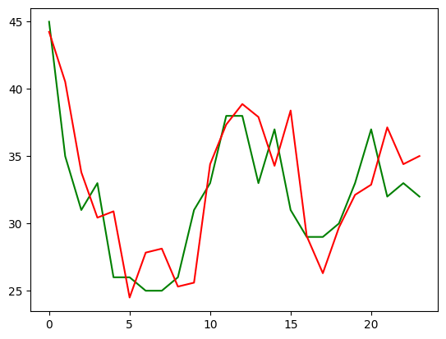
Time Series Modeling ARIMA Forecast: Test set
‹#›
RMSE: RMSE: 3.36405
Notes:
RMSE smaller for test than train set?

Slide 15
Results

Slide 16
Summary
In this project we have successfully…
Utilized OpenCV and EasyOCR libraries to extract datetime and count of cars from a picture dataset.
Preprocessed the extracted data to handle inaccurately extracted values and convert datetime information into a suitable format for time series analysis.
Trained an ARIMA model to forecast the number of cars passing a road based on historical data.
Evaluated the ARIMA model's performance using the RMSE metric to ensure accuracy.
Used the trained ARIMA model to make predictions for the number of cars passing the road in the next 24 hours.

Slide 17
Conclusion
The combination of computer vision and time series analysis provided valuable insights for traffic management and planning.
Further optimization and fine-tuning of the model could potentially improve its accuracy and predictive power.
The project demonstrates the effectiveness of OCR technology and generative AI in solving real-world problems.
Time series forecasting can aid in traffic optimization and urban planning for better traffic flow and management.
The project highlights the importance of data quality and model parameters in achieving accurate predictions.

Slide 18
Acknowledgements & Appreciation
Chandan Verma
Provided valuable insights on possible use cases and initiation point.
Osvaldo Velazquez
Critiqued data quality and gave ideas on possible data collection methods
Jaime Ruiz
Provided master guidance on project route
Understood our struggles and patiently gave us time and help when requested

Slide 19

Thank you
‹#›

